Slide 1
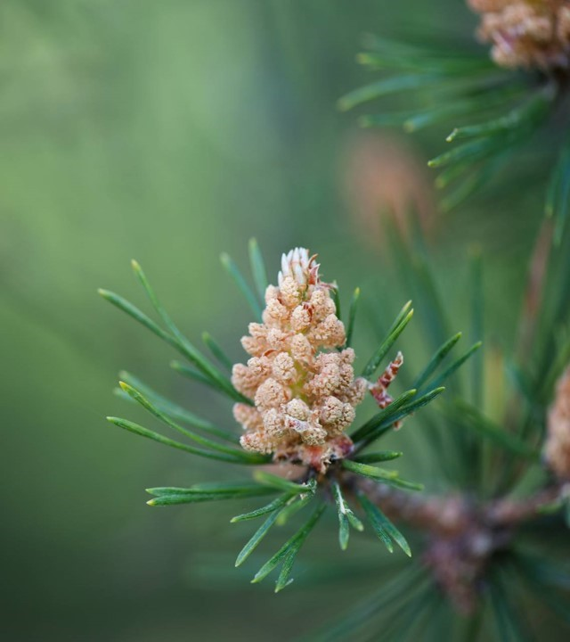
Wildfire risk and weather metrics prediction for Canada Alexandra Landry Capstone project May 2024
Concordia University continuing education

Slide 2
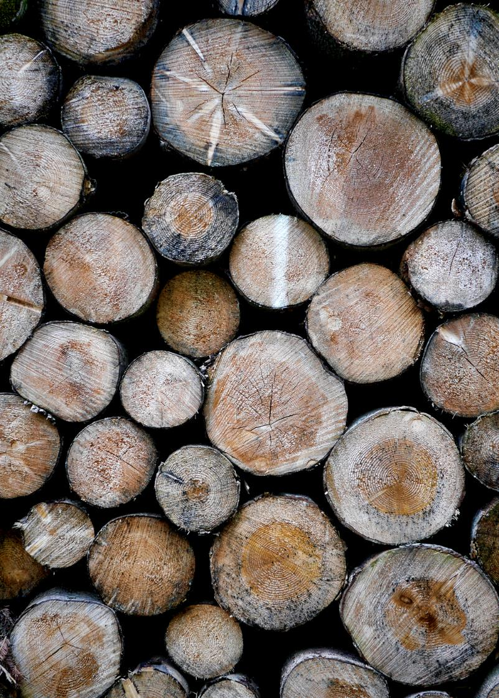
Table of content
Project objective
Data gathering
Project evolution
Feature selection
Predictor selection
Model selection
Models testing
Models training, tuning and validation
Streamlit deployment
Conclusion

Slide 3
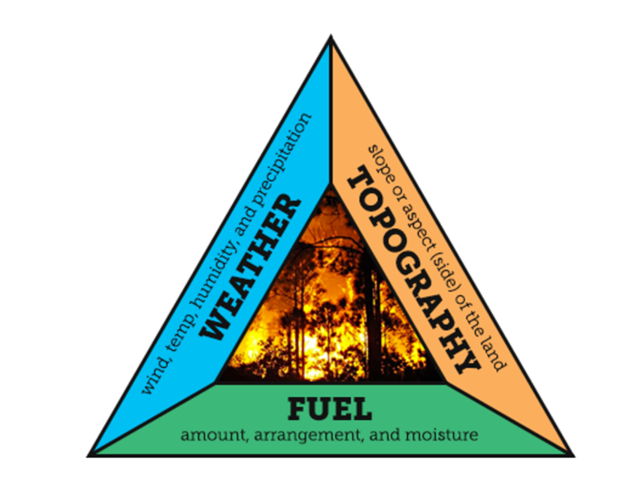
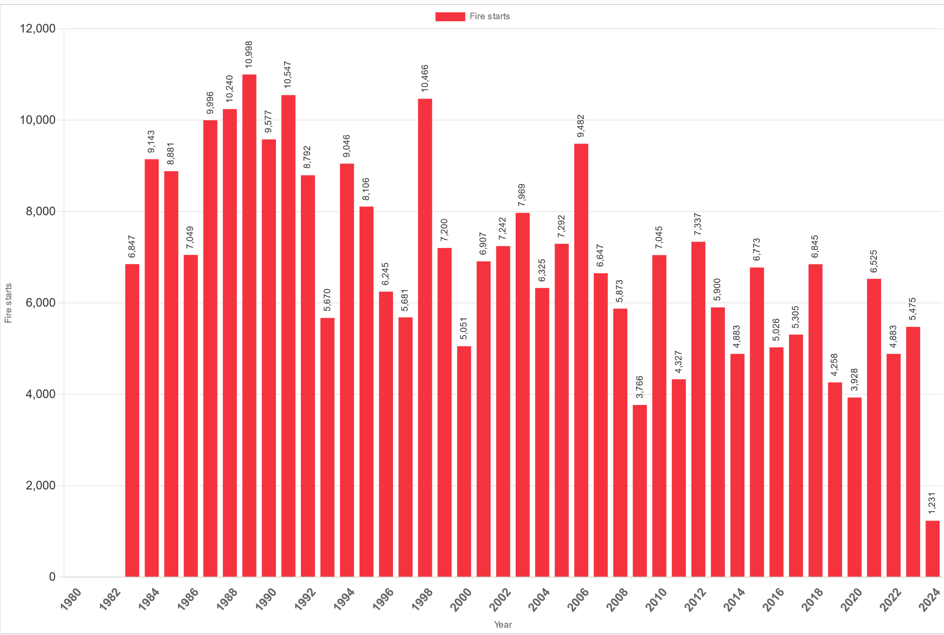
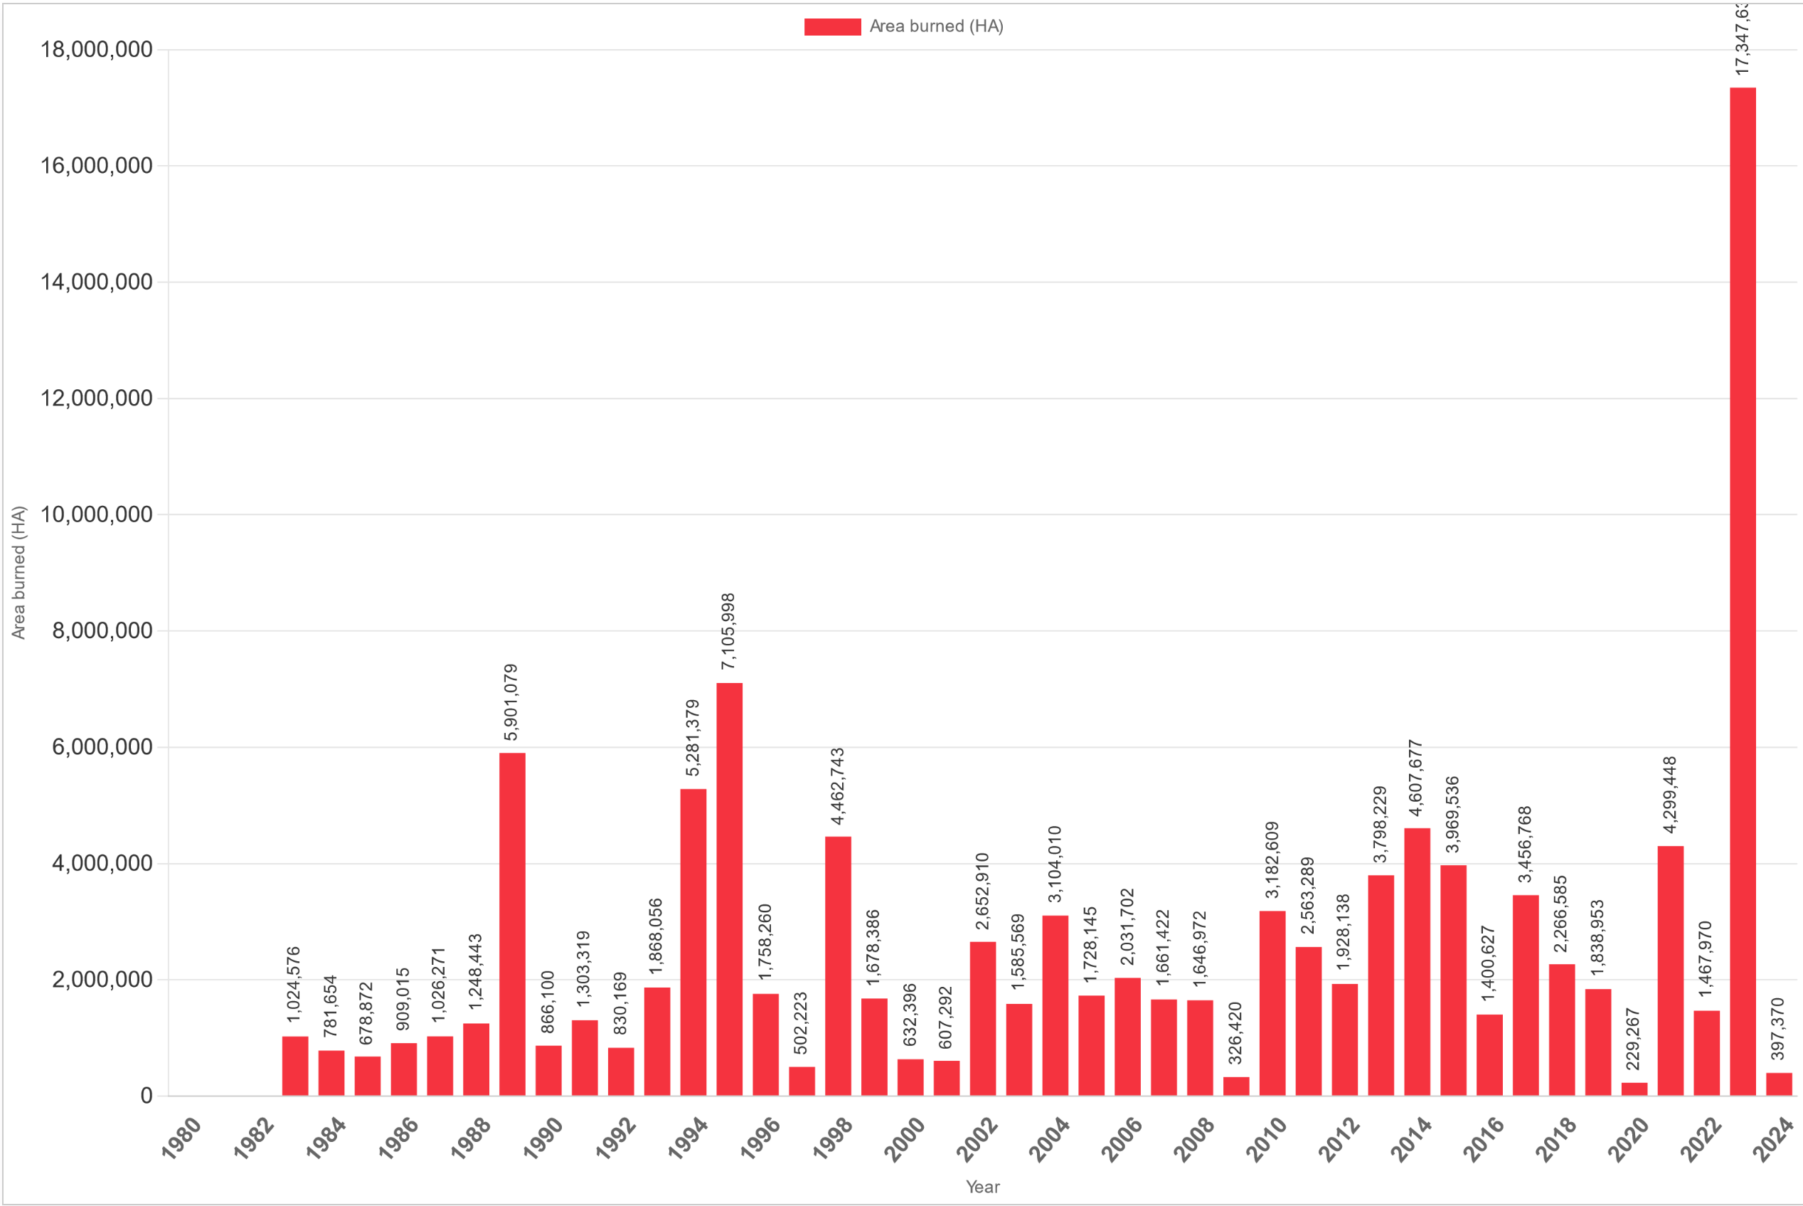
Project objective
The first idea behind this project was to predict wildfire risk base on region and on past season weather
Wildfire understanding:
Wildfire in Canada, 2 main causes:
Lightning
Human (responsible for more than half)
Types of wildfires:
Crown fires
Surface fires
Ground fires
https://www.canadawildfire.org/wildfirefacts
Number of fire
Area burned
https://ciffc.net/statistics

Slide 4
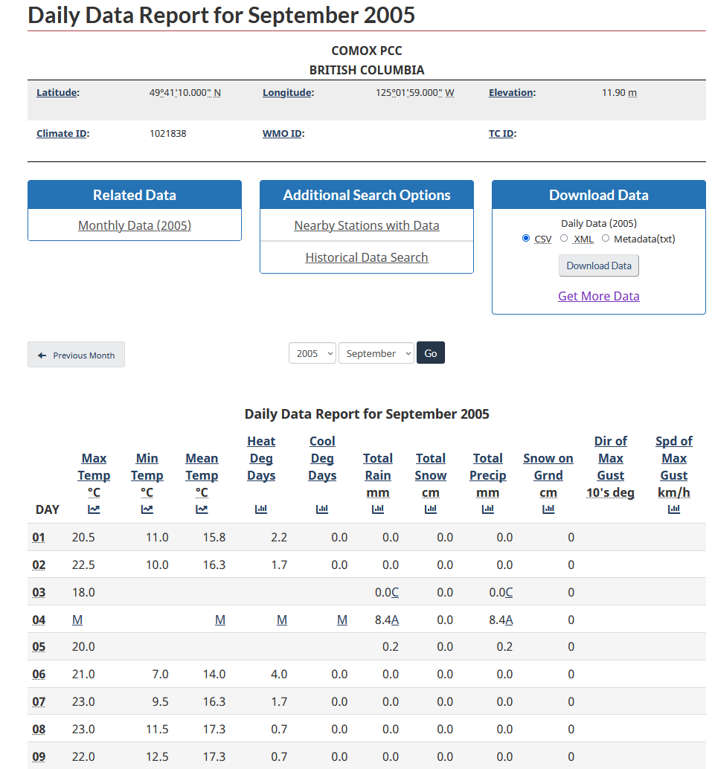
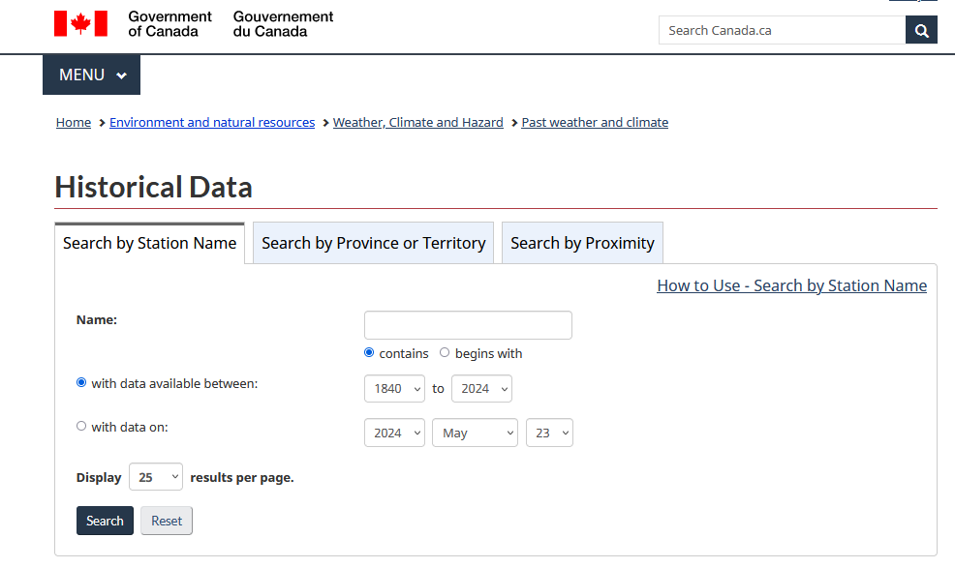
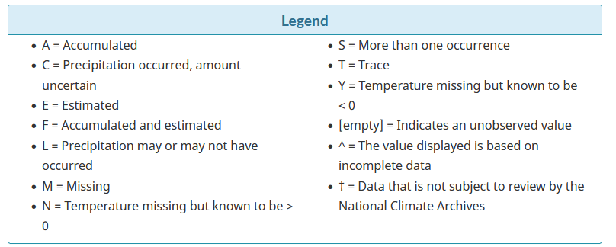
Weather Data
https://climate.weather.gc.ca/historical_data/search_historic_data_e.html

Slide 5
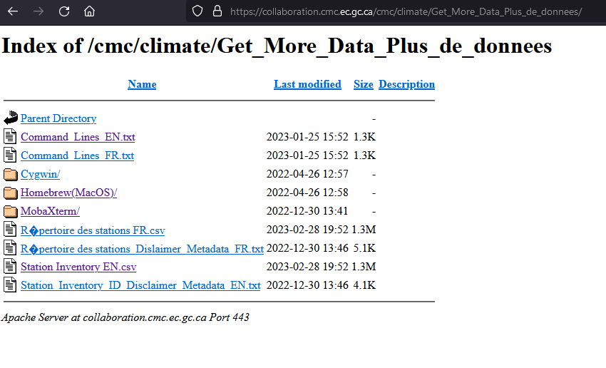
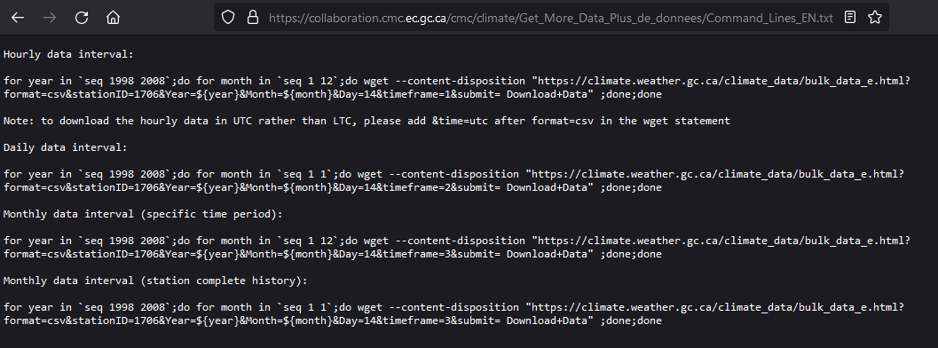
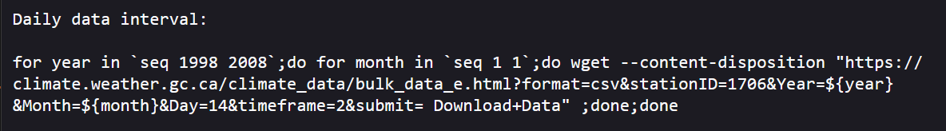
Weather Data
Containing list of all weather station in the historical data from Government of Canada

Slide 6
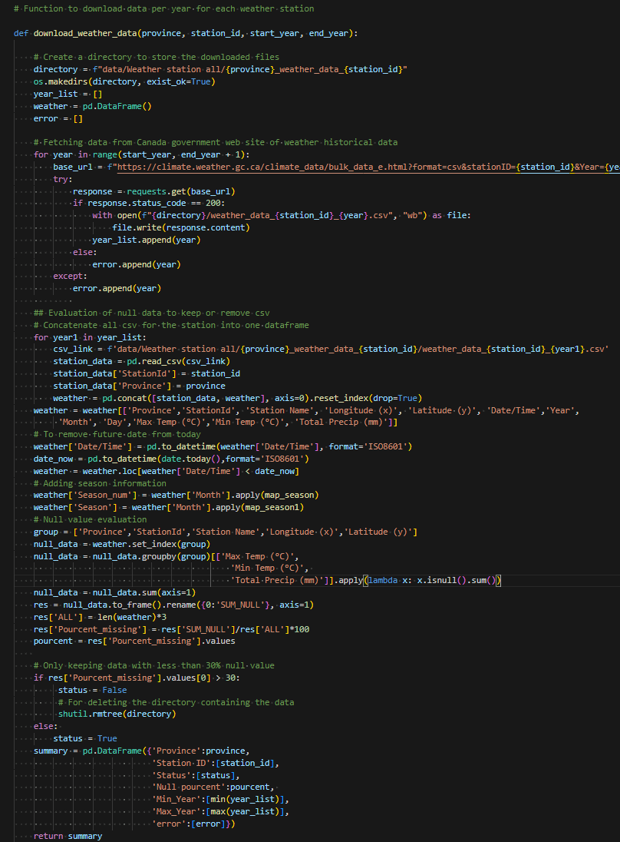
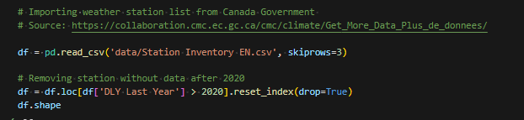
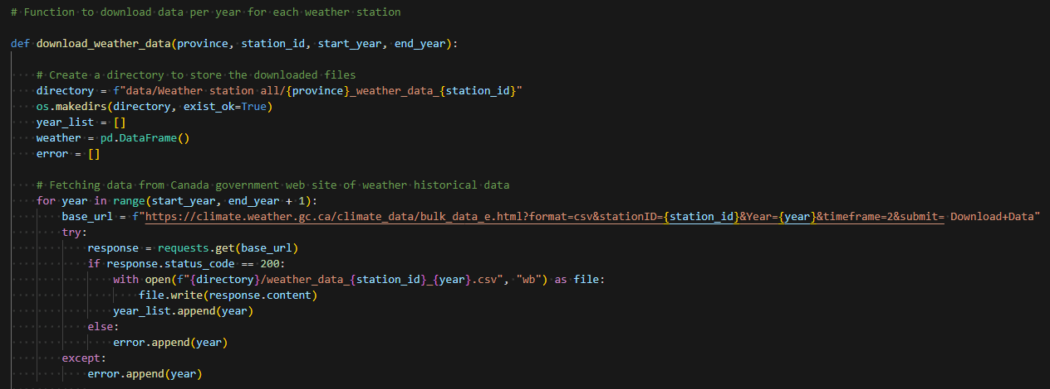
Weather data extraction

Slide 7
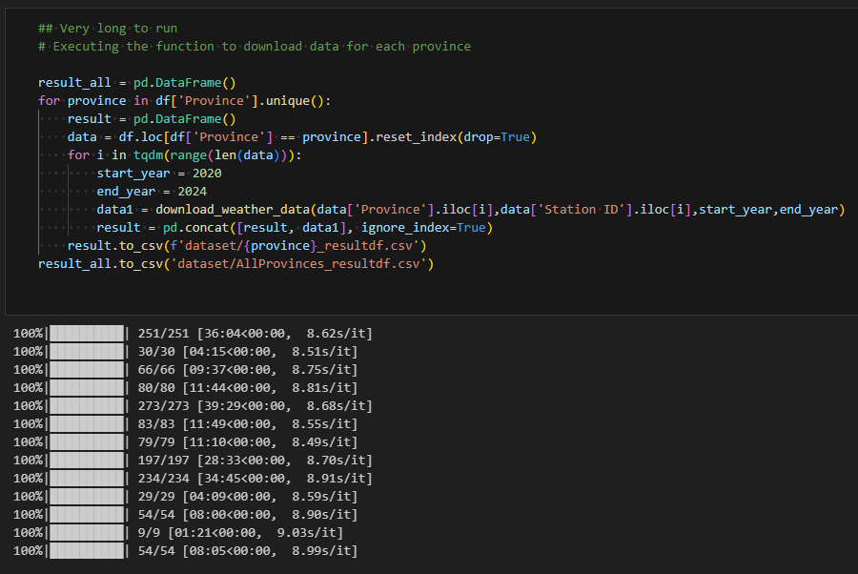
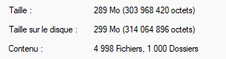
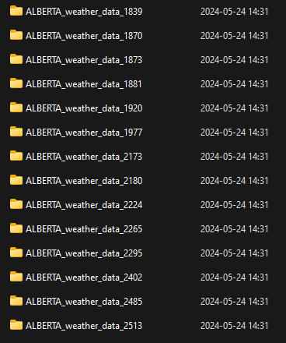
Merge data
From tqdm library

Slide 8
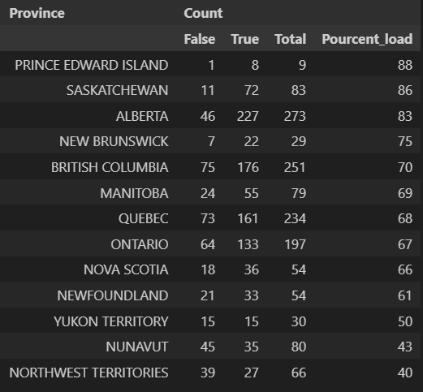
Active weather stations
Analysis of stations with missing values per province and territories in Canada
True: Less than 30% missing values
False: More than 30% missing values

Slide 9
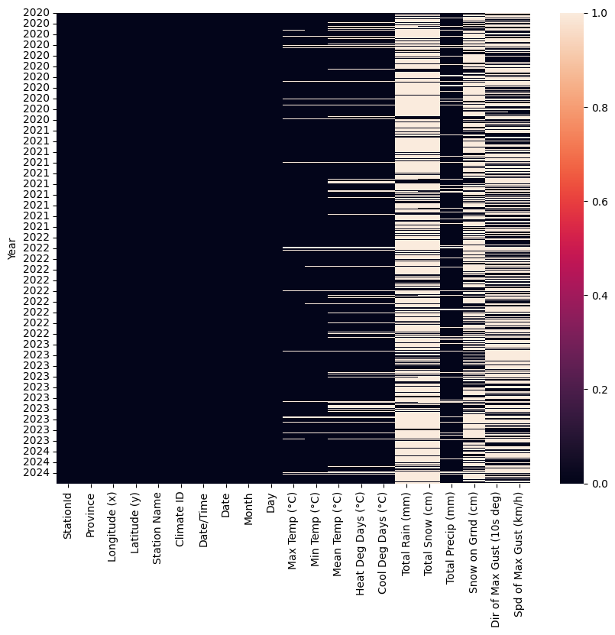
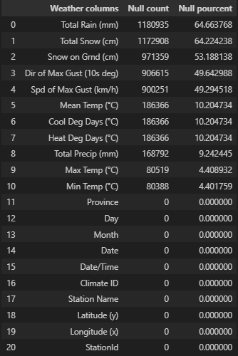
Data quality
Null value in the Gouvernment of Canada historical data

Slide 10
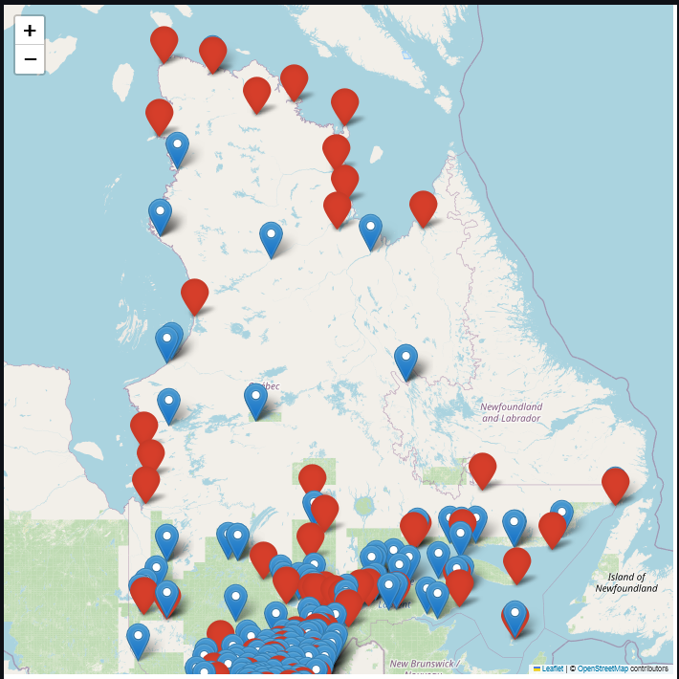
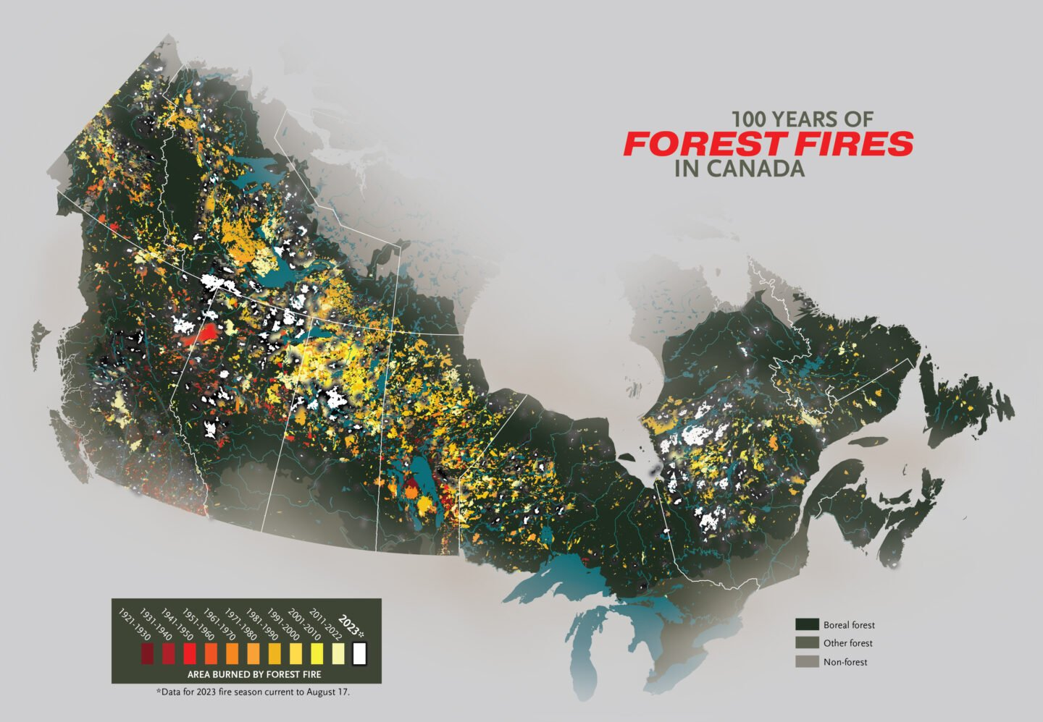
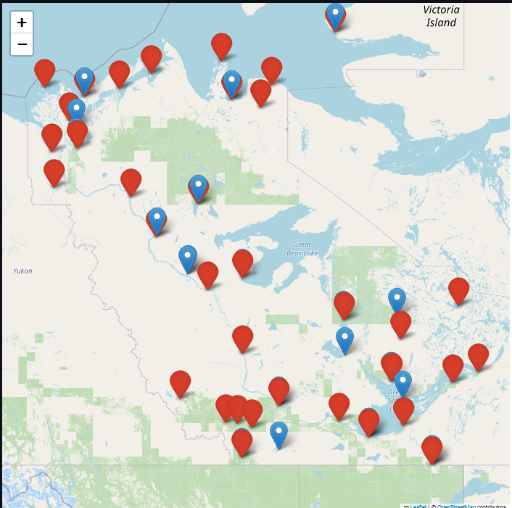
Wildfires location
Québec
https://canadiangeographic.ca/articles/mapping-100-years-of-forest-fires-in-canada/
Northwest Territories

Slide 11
Project evolution
There is to much missing data to be specific when training the model
Revised project objective:
Predict weather metrics for weather station with missing values for Canada provinces and territories
Features:
Station localization and elevation,
Year, Month, Day
Season
Prediction metrics:
Minimum, Average and Maximum temperature per day
total precipitation per day
Models:
Linear regression

Slide 12
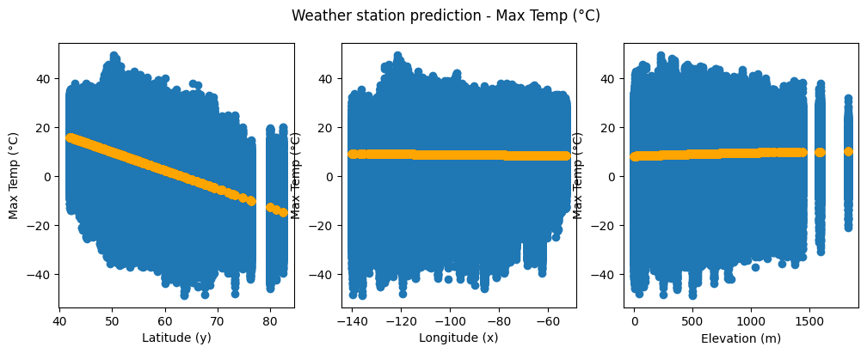
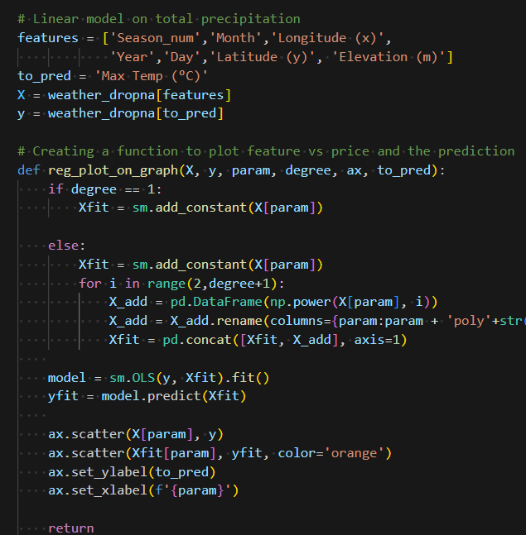
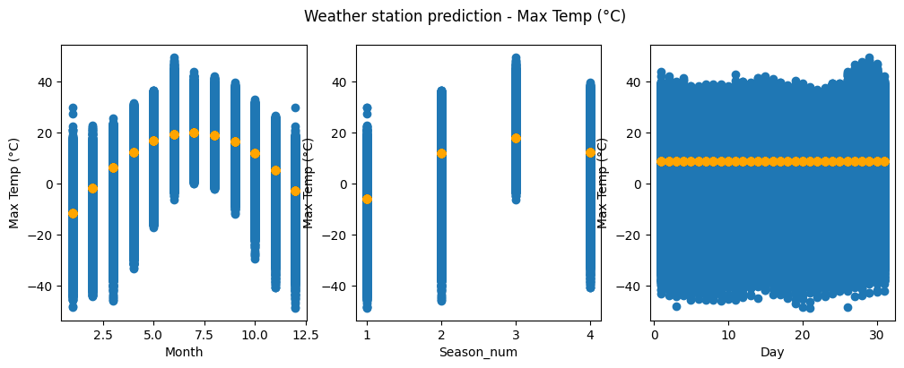
Features Visualization with Statsmodel

Slide 13
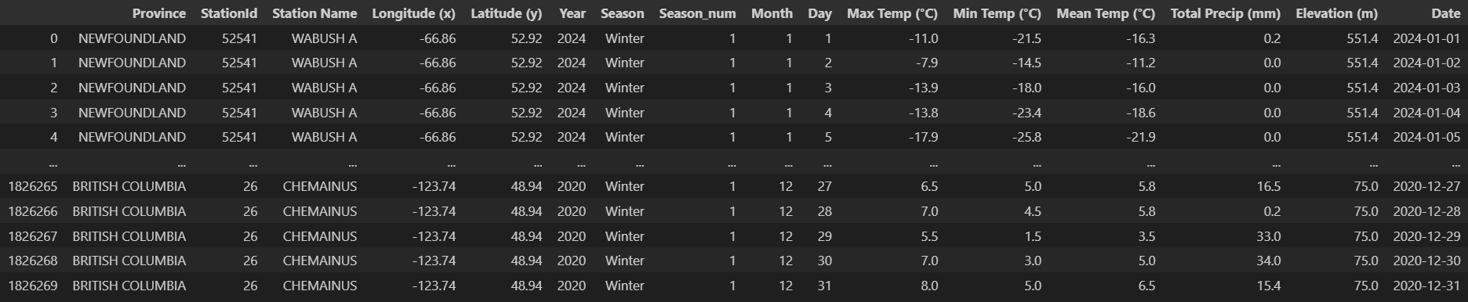
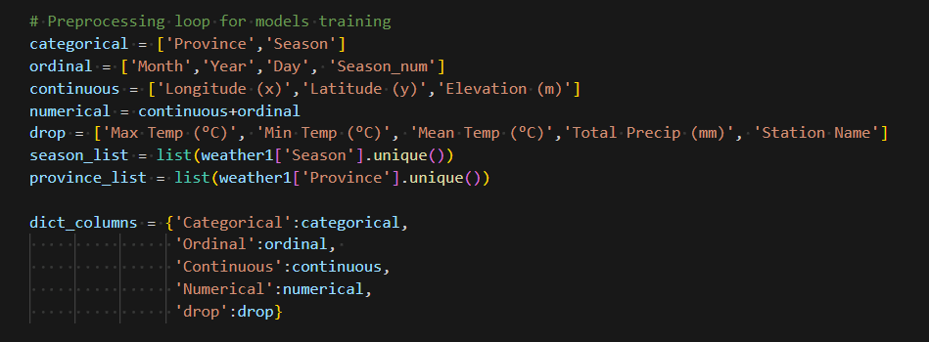
Preprocessing
Preparing to do the encoder for categorical data and scaling for numerical data

Slide 14
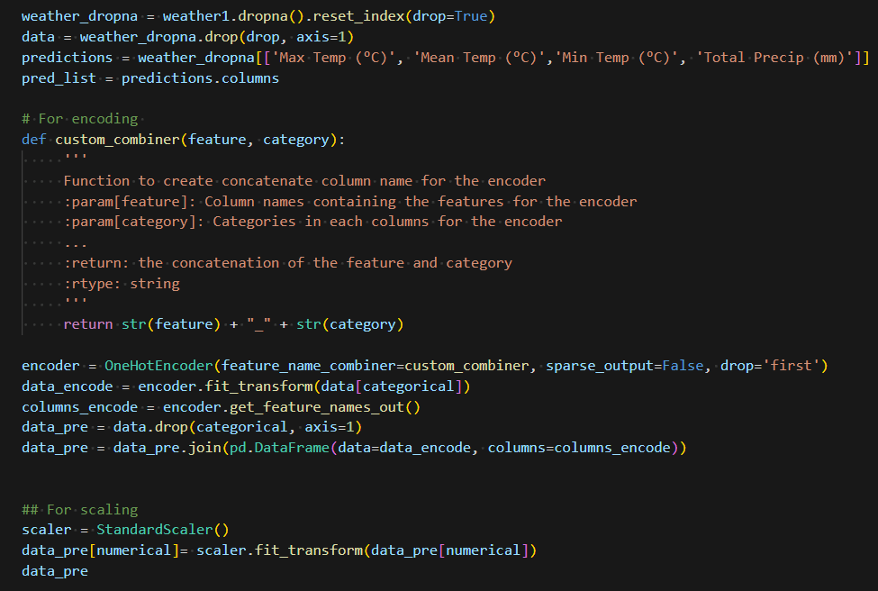
Preprocessing
Drop missing weather data
Encoding with OneHotEncoder() from scikit-learn
Scaling with StandardScaler() from scikit-learn

Slide 15
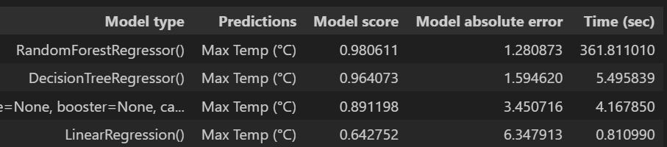
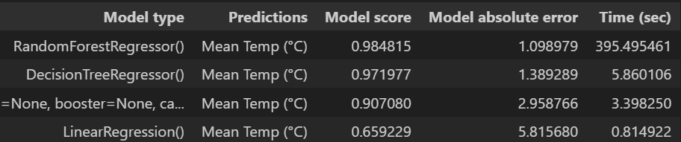
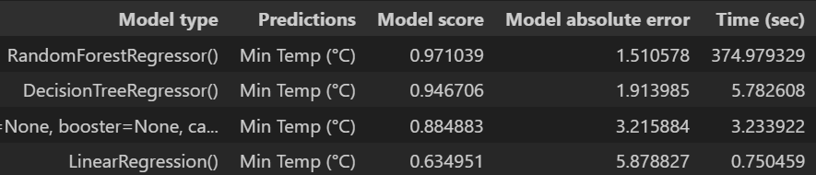
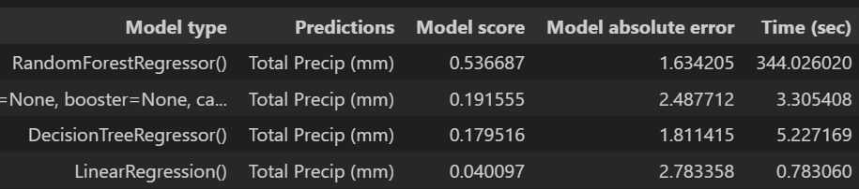
MODELs testing
From Scikit-Learn:
LinearRegression()
ElasticNet()
HubertRegression()
DecisionTreeRegressor()
RandomForestRegressor()
XGBRegressor()
From Keras:
Neural network

Slide 16
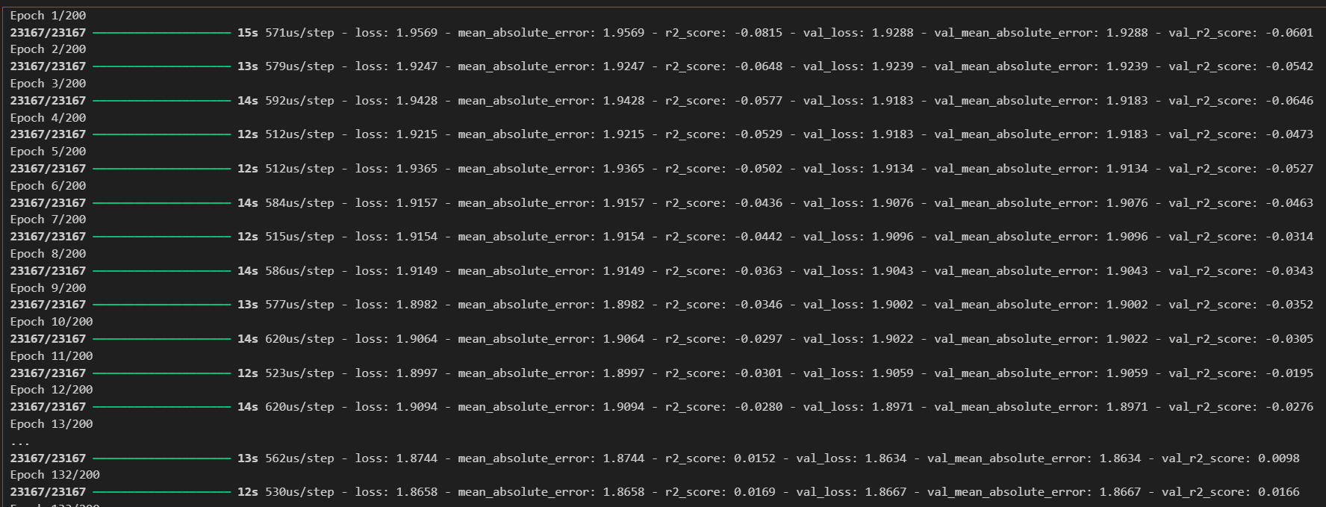
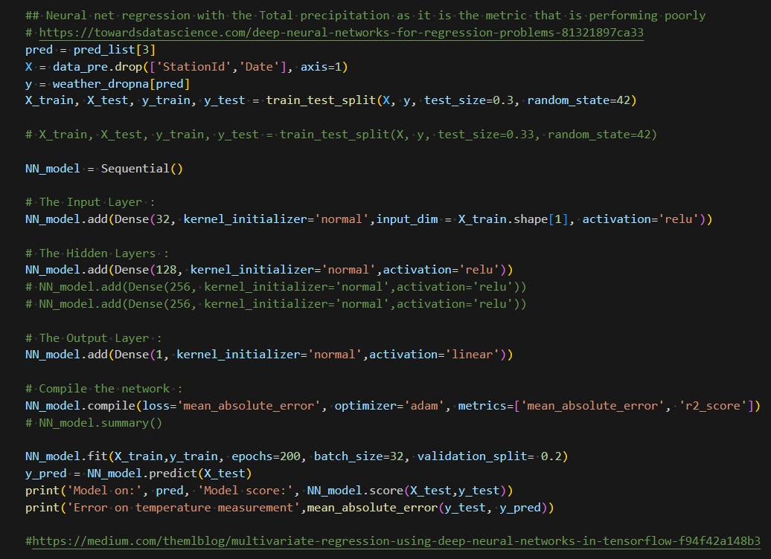
MODELs testing
Neural net for regression (only one output)
Very long to run
Poor output score
R2 less than 0.02 after 130 epoch

Slide 17
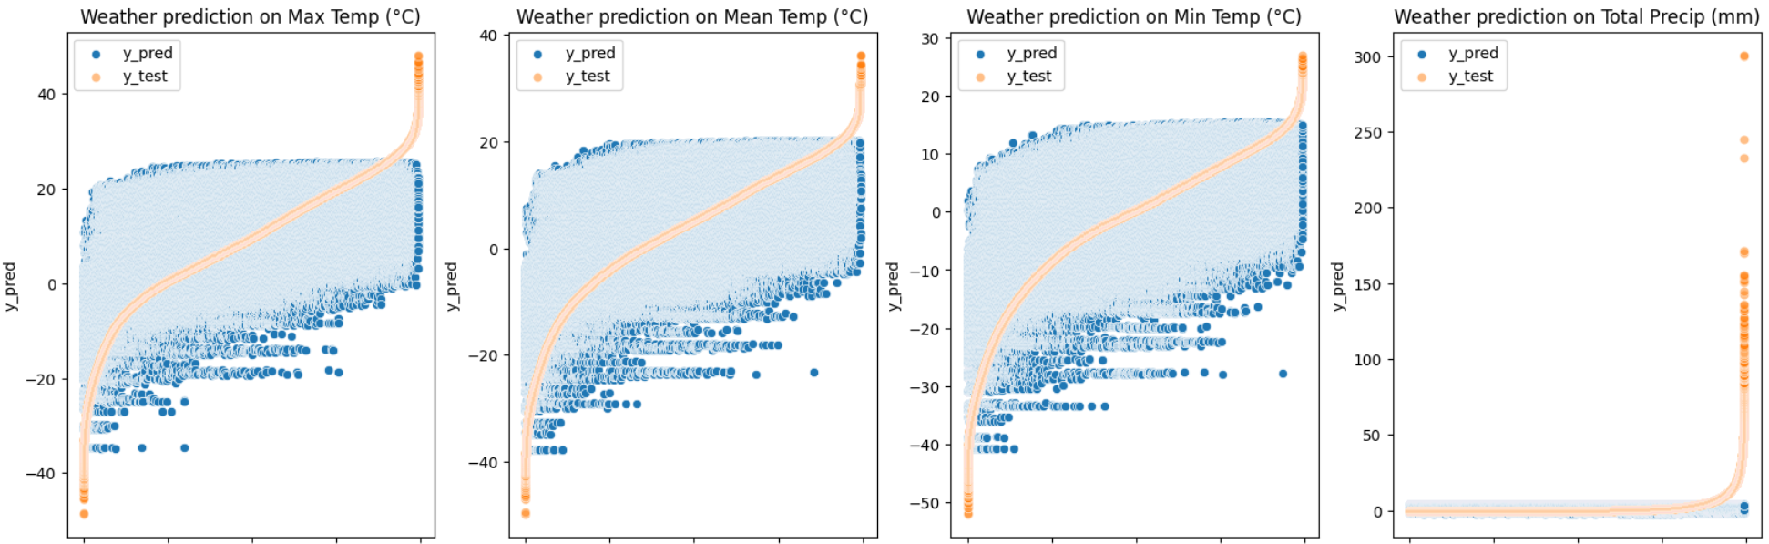
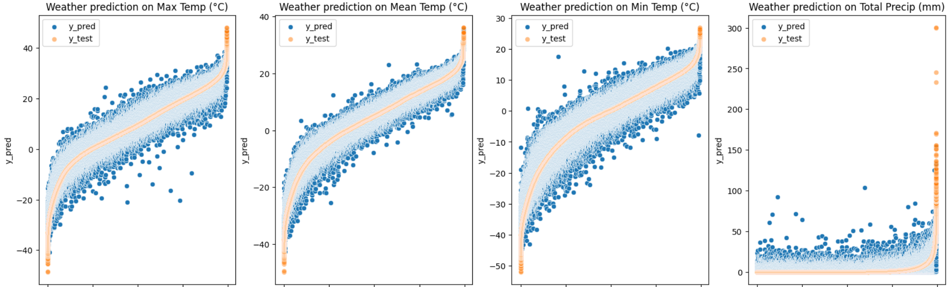
Visualization of prediction
LinearRegression()
RandomForestRegressor()

Slide 18
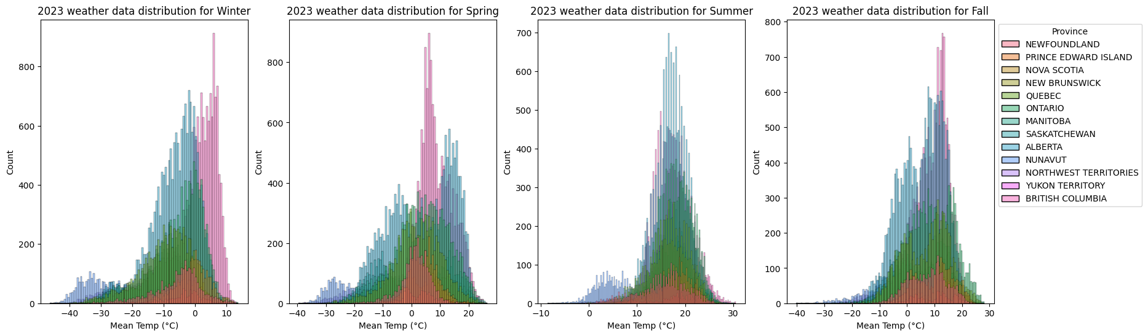
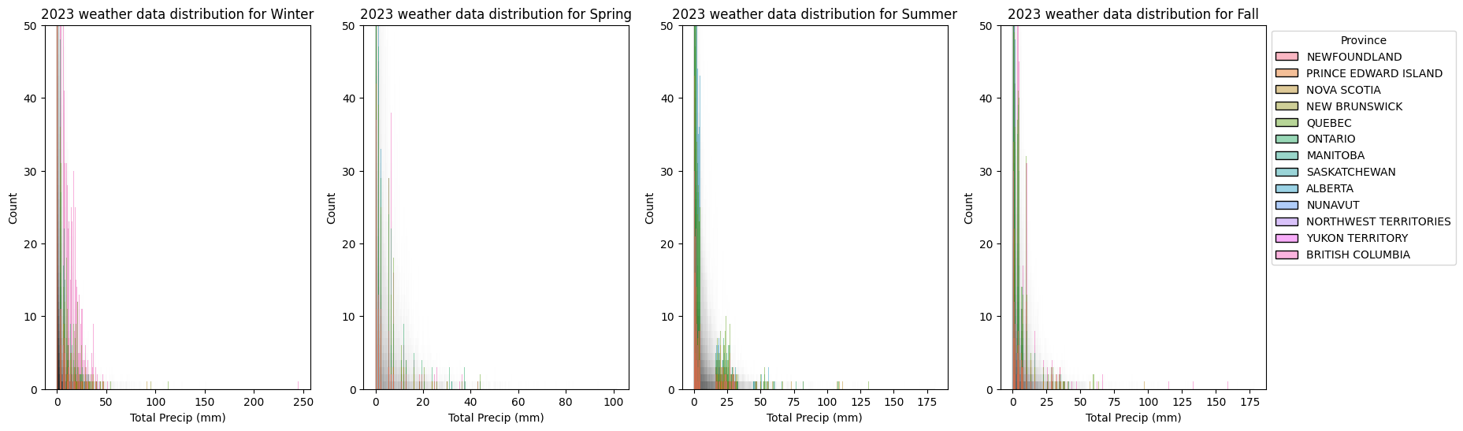
Mostly normal distribution
Poisson distribution

Slide 19
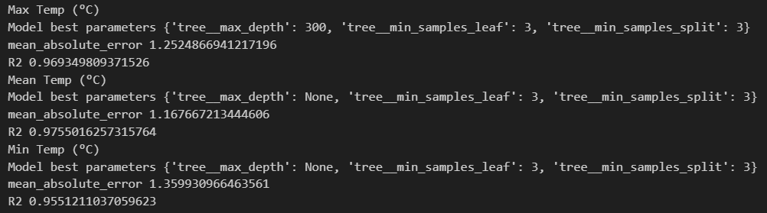
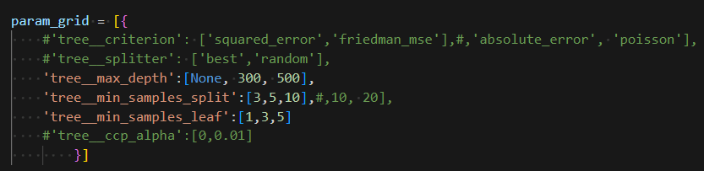
MODELs fine tuning
With GridSearch from scikit-learn

Slide 20
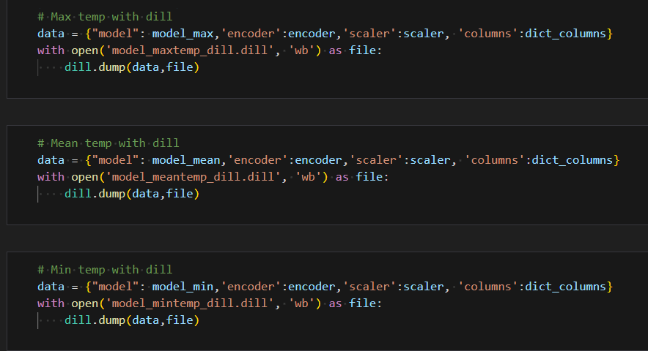
MODELs fine tuning

Slide 21
Streamlit Application Code and Demo

Slide 22
Next step
Precipitation model:
Try different models for Poisson distribution
Find more features for weather
Humidity
Atmospheric pressure
Climate location (Coast vs prairies)
Models deployment:
Research more on the rooth cause
Try to simplify models to reduce memory
Try to deploy with an other app

Slide 23
Conclusion
Model input and output initial planning
Understanding of data distribution and data type
Exploration on model possibilities
Computer science knowledge
Github

Slide 24
Thank you
Project Repo: https://github.com/Alexlalandry/Canada_weatherstation_prediction.git
Alexandra Landry
Github: alexlalandry
Discord: alexandralandry
Email: alexandra.landry.b@gmail.com

